Slide 1

Machine Learning And Data Analysis
Akın Kemal DOĞANGÜN

Slide 2
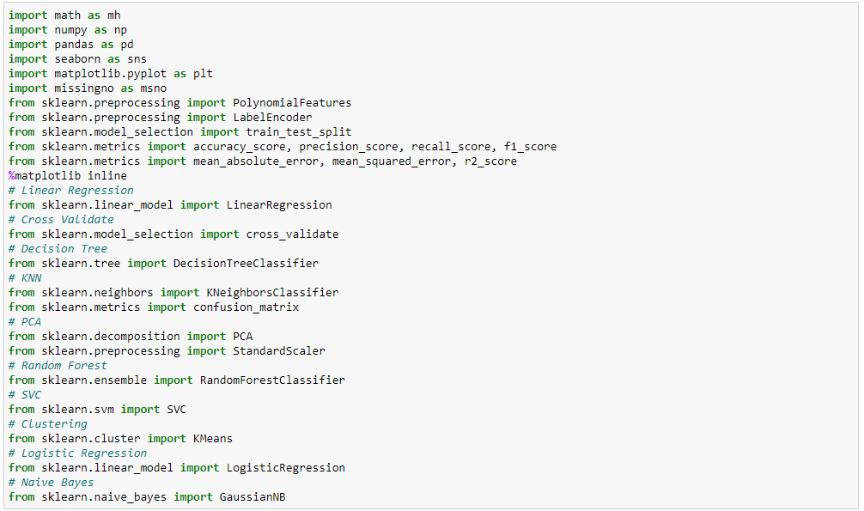
import libraries

Slide 3



Data Collection
Term Project

Slide 4
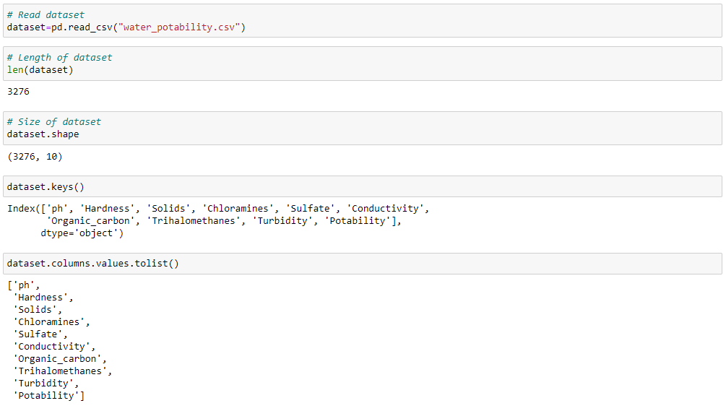

Slide 5
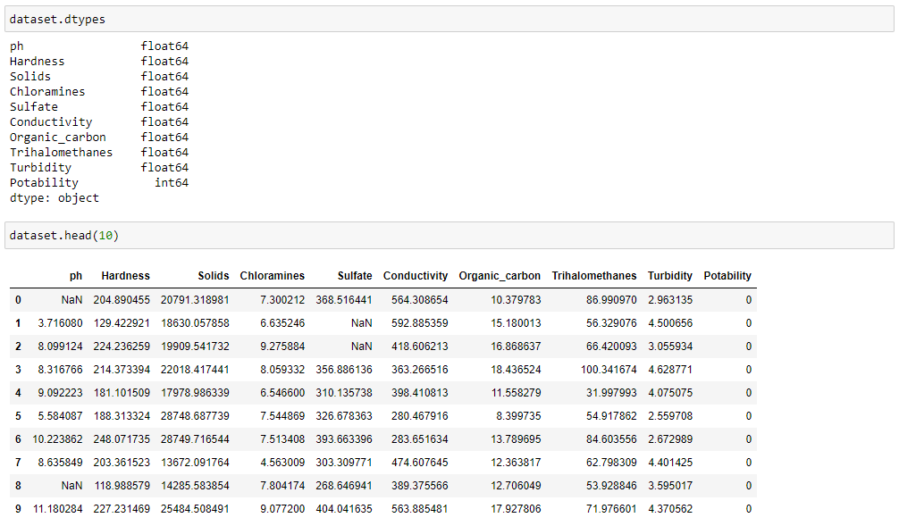

Slide 6
Data Collection
pH Value: pH is a crucial parameter for assessing the acid-base balance of water and determining its acidic or alkaline nature. The World Health Organization (WHO) recommends a maximum permissible pH range of 6.5 to 8.5 for water. The investigation results fall within the WHO standards, with values ranging from 6.52 to 6.83.
Hardness: Hardness in water is primarily caused by the presence of calcium and magnesium salts, which dissolve from geological deposits as water travels through them. The duration of contact between water and hardness-producing materials determines the level of hardness in the water. Hardness was originally defined based on the water's capacity to precipitate soap due to the presence of calcium and magnesium.
Total Dissolved Solids (TDS): Water can dissolve various inorganic and organic minerals or salts such as potassium, calcium, sodium, bicarbonates, chlorides, magnesium, and sulfates. These minerals can impart an undesirable taste and diluted appearance to water. TDS is an important parameter for water use. The desirable limit for TDS in drinking water is 500 mg/L, with a maximum limit of 1000 mg/L.

Slide 7
Data Collection
Chloramines: Chlorine and chloramine are commonly used disinfectants in public water systems. Chloramines are formed when ammonia is added to chlorine for treating drinking water. Chlorine levels up to 4 milligrams per liter (mg/L) or 4 parts per million (ppm) are considered safe in drinking water.
Sulfate: Sulfates are naturally occurring substances found in minerals, soil, rocks, ambient air, groundwater, plants, and food. They are widely used in the chemical industry. In seawater, sulfate concentration is approximately 2,700 mg/L, while in most freshwater supplies, it ranges from 3 to 30 mg/L. Some locations may have higher concentrations of up to 1000 mg/L.
Conductivity: Pure water is a poor conductor of electric current and acts as an insulator. However, the presence of ions in water increases its electrical conductivity. The amount of dissolved solids in water determines its electrical conductivity. According to WHO standards, the electrical conductivity (EC) value should not exceed 400 μS/cm.

Slide 8
Data Collection
Organic Carbon: Total Organic Carbon (TOC) in water sources originates from decaying natural organic matter (NOM) as well as synthetic sources. TOC measures the overall carbon content in organic compounds present in pure water. The US Environmental Protection Agency (EPA) recommends a TOC level of less than 2 mg/L in treated/drinking water and less than 4 mg/L in source water used for treatment.
Trihalomethanes: Trihalomethanes (THMs) are chemicals that may be found in water treated with chlorine. The concentration of THMs in drinking water varies based on the organic material content, the amount of chlorine used for treatment, and the water temperature. THM levels up to 80 ppb (parts per billion) are considered safe in drinking water.

Slide 9
Data Collection
Turbidity: Turbidity is a measure of the solid particles present in water in a suspended state. It indicates the light-emitting properties of water and is used to assess the quality of waste discharge concerning colloidal matter. The mean turbidity value obtained for the Wondo Genet Campus is 0.98 NTU (Nephelometric Turbidity Units), which is lower than the WHO recommended value of 5.00 NTU.
Potability: Potability refers to whether water is safe for human consumption. A value of 1 indicates potable (safe for drinking), while a value of 0 indicates non-potable (not safe for drinking).

Slide 10
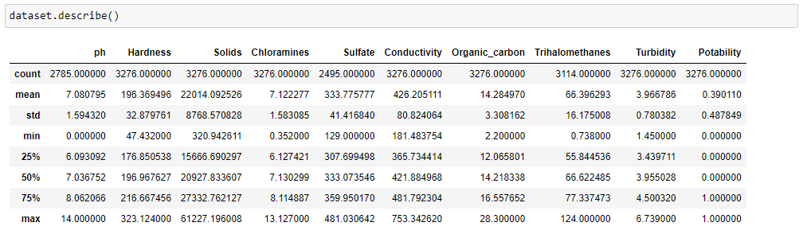
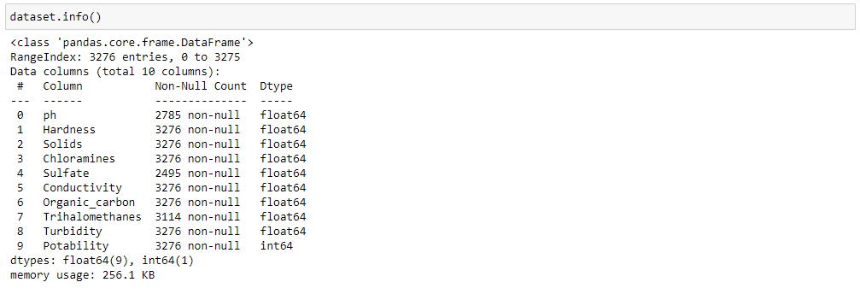

Slide 11



Select Target Value
Term Project

Slide 12
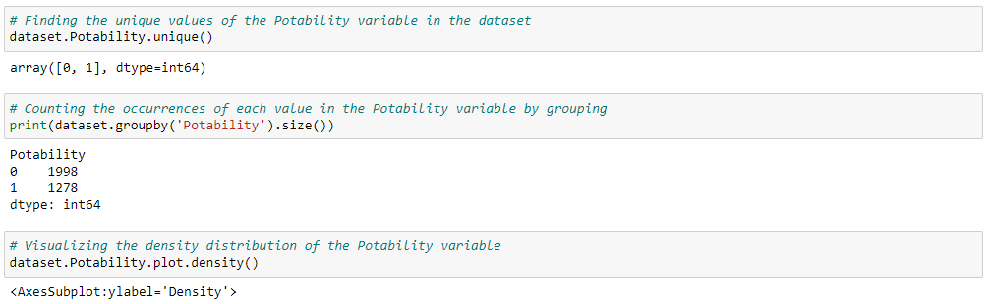
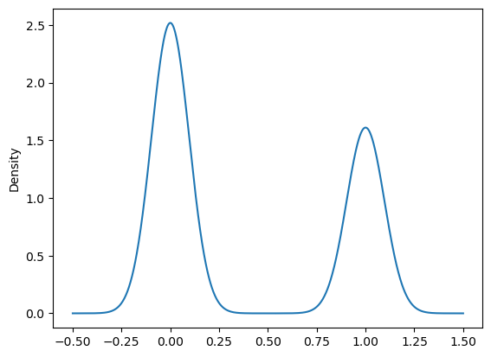

Slide 13
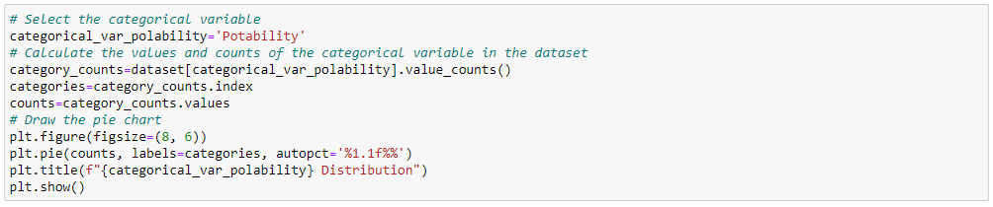
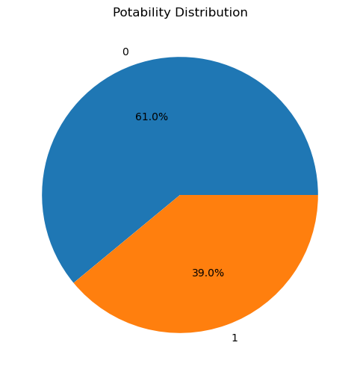

Slide 14
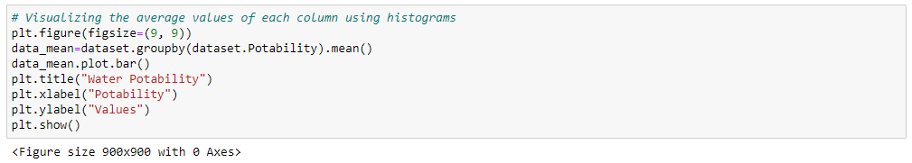
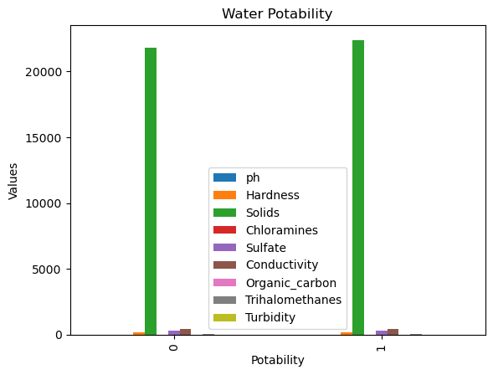

Slide 15
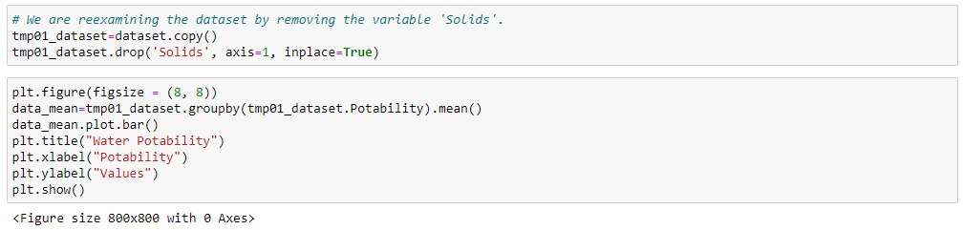
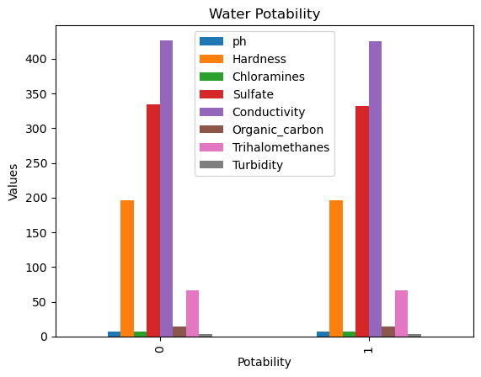

Slide 16
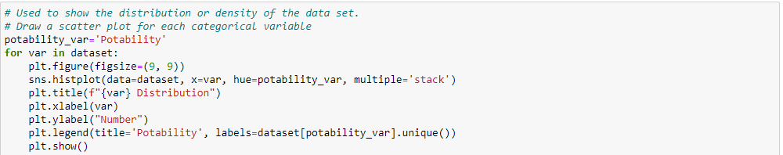
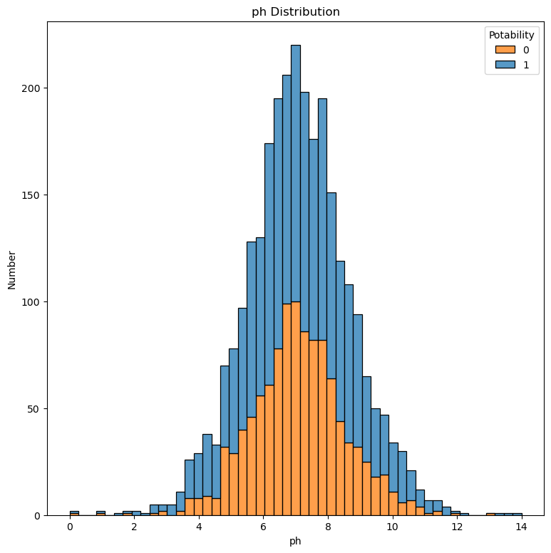
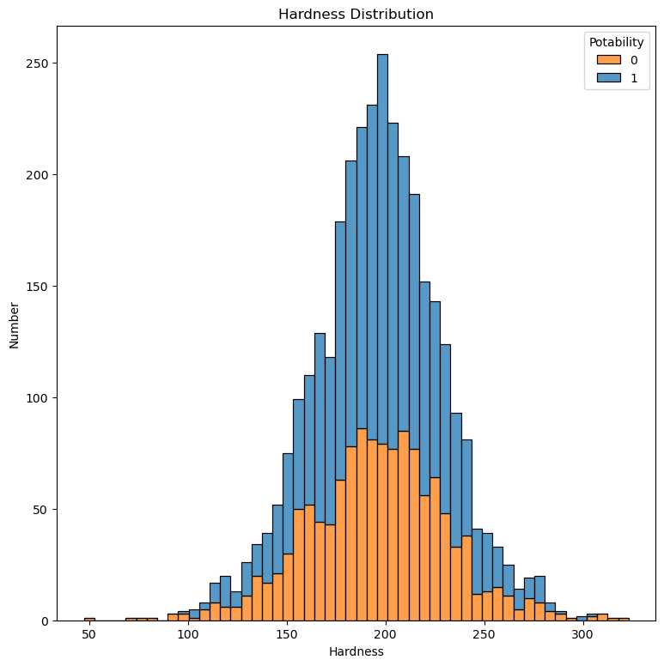
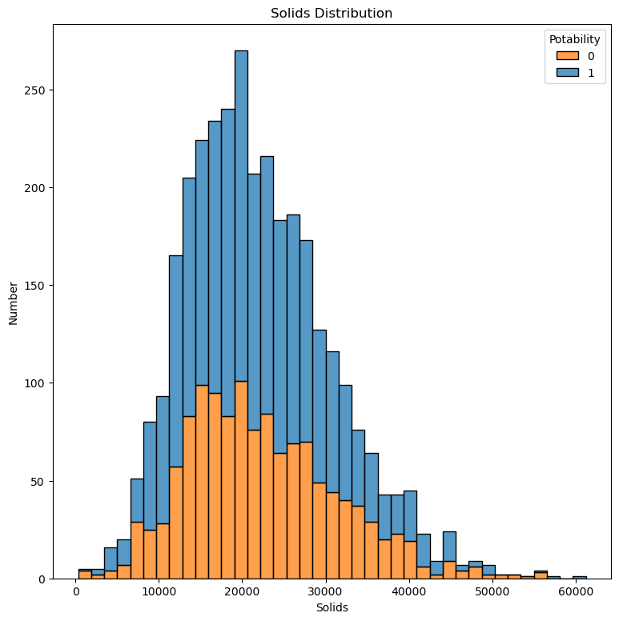

Slide 17
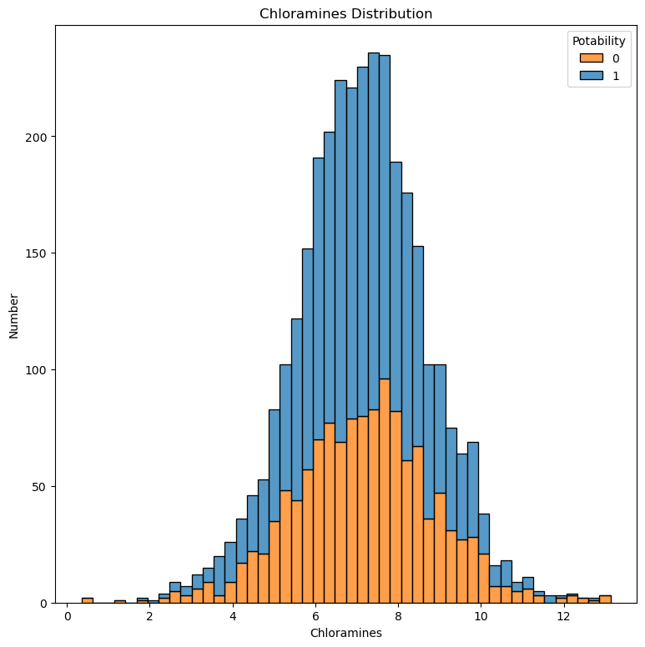
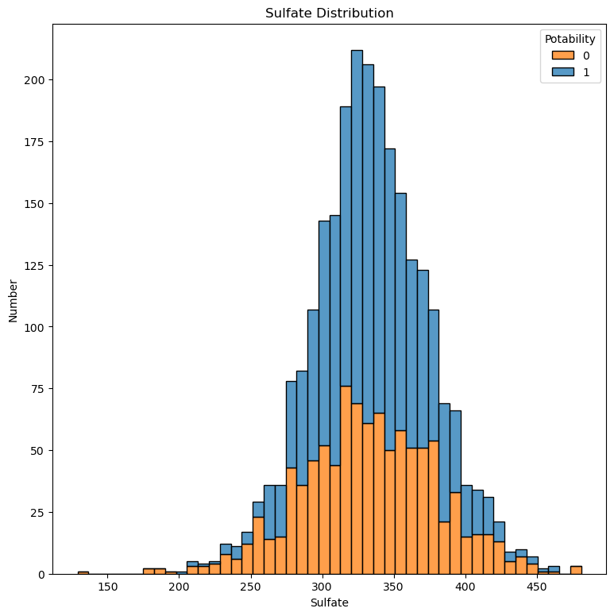
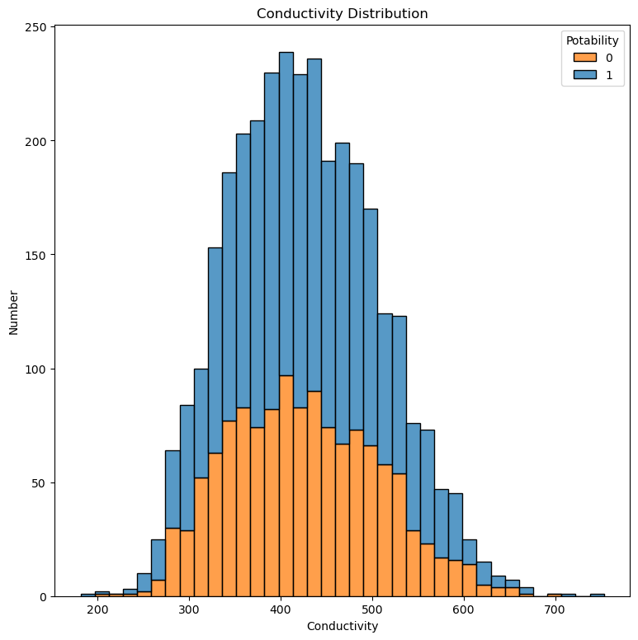
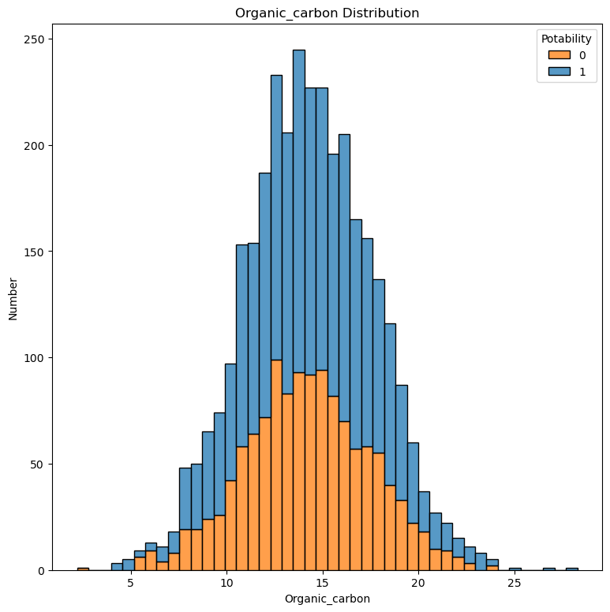
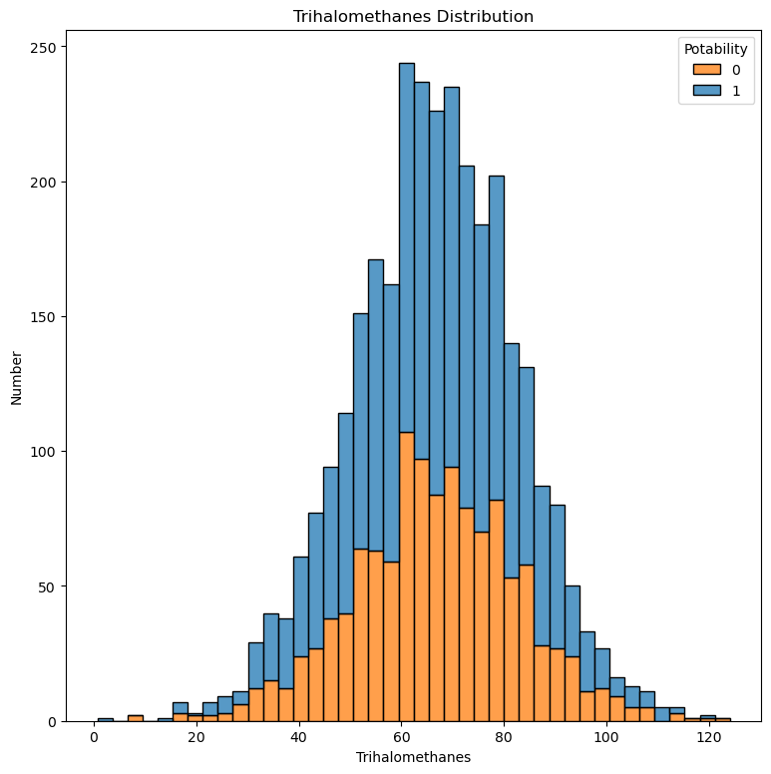
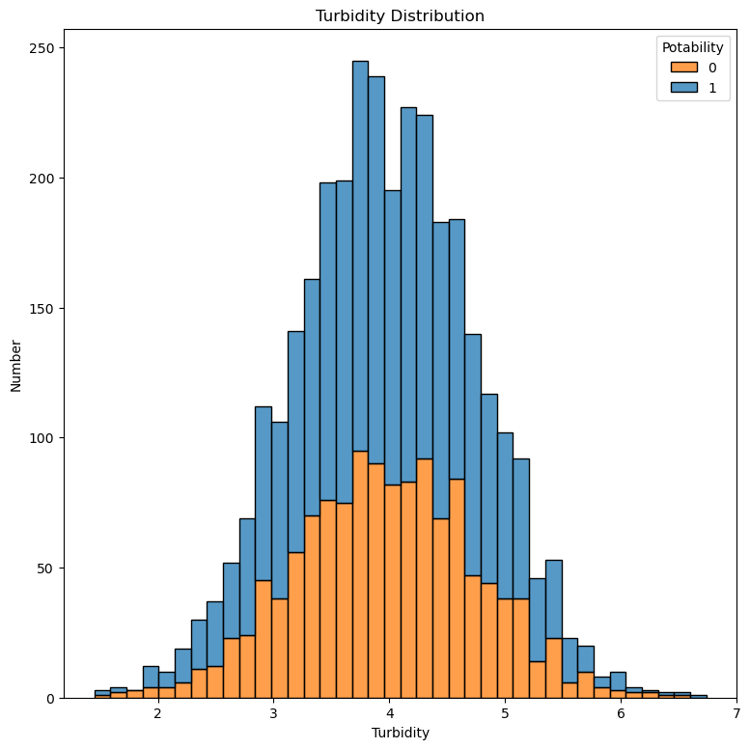

Slide 18
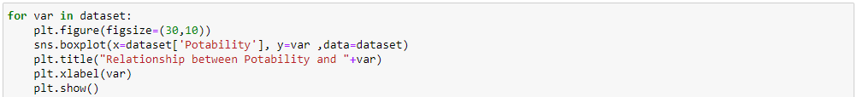
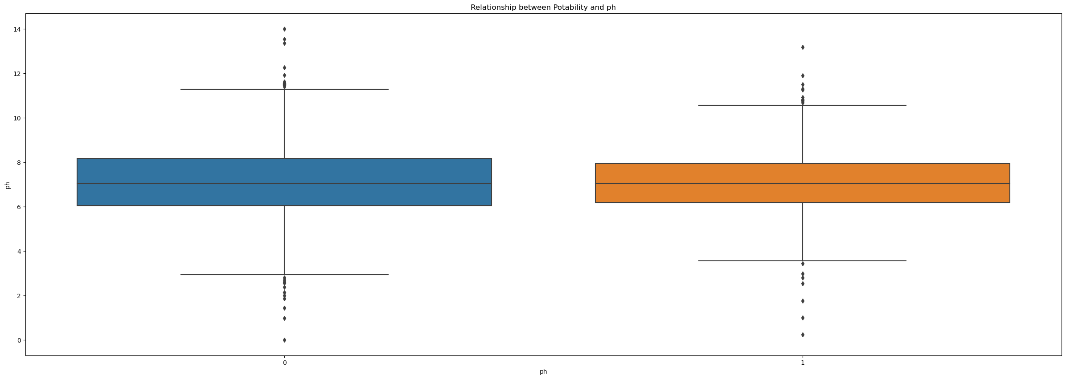
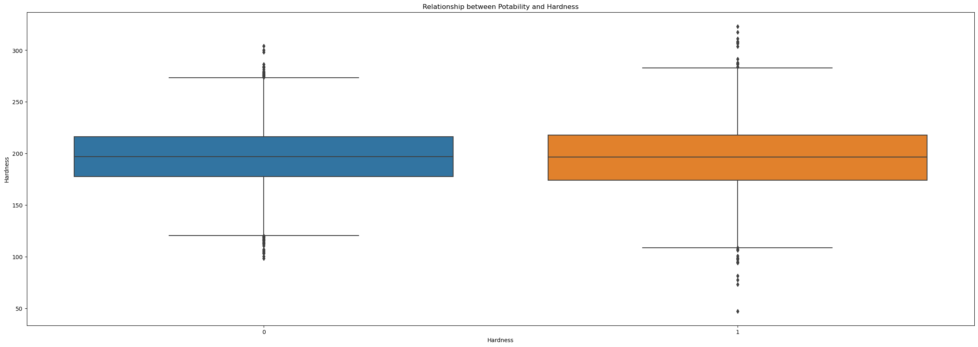
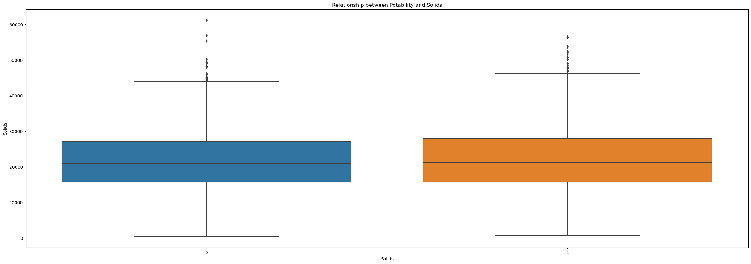


Slide 19
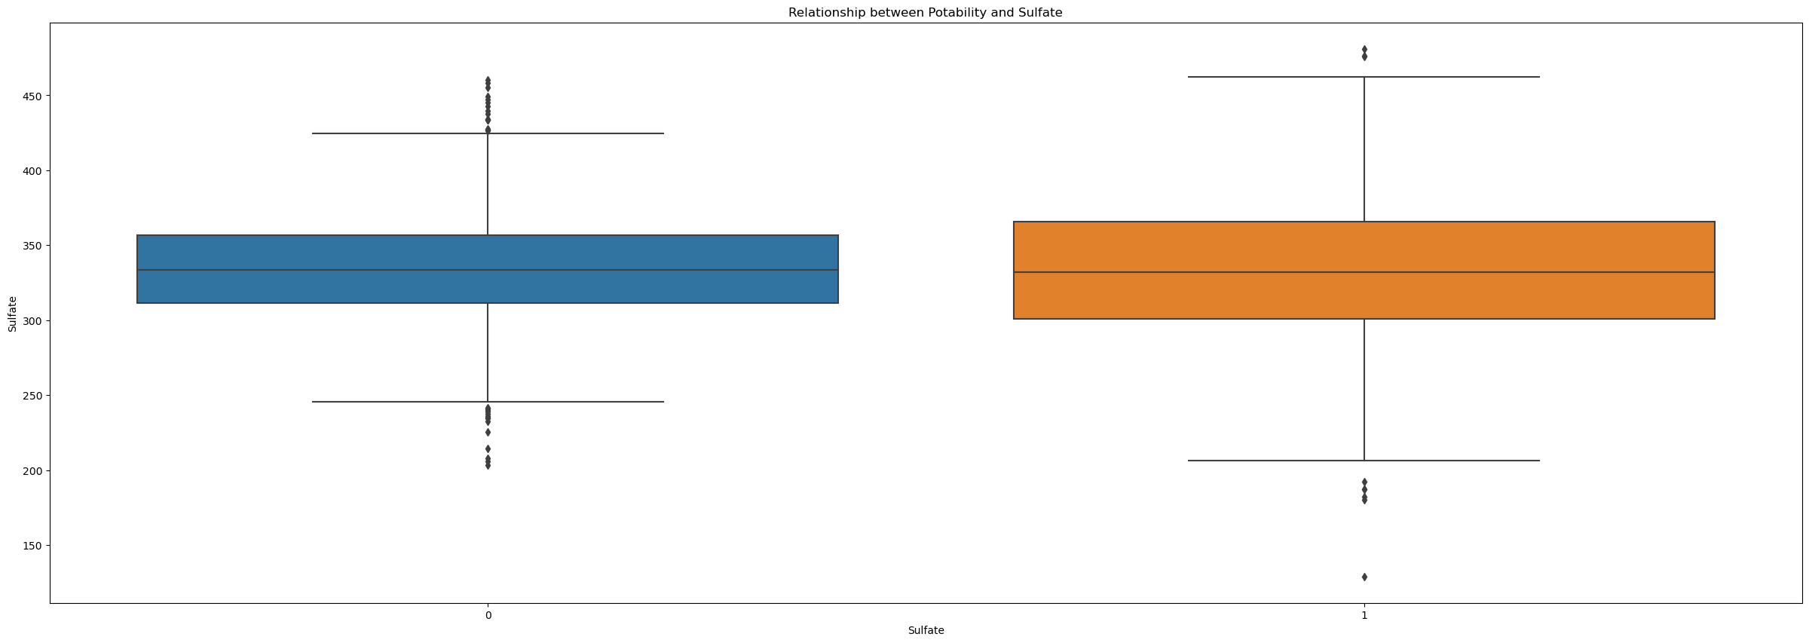
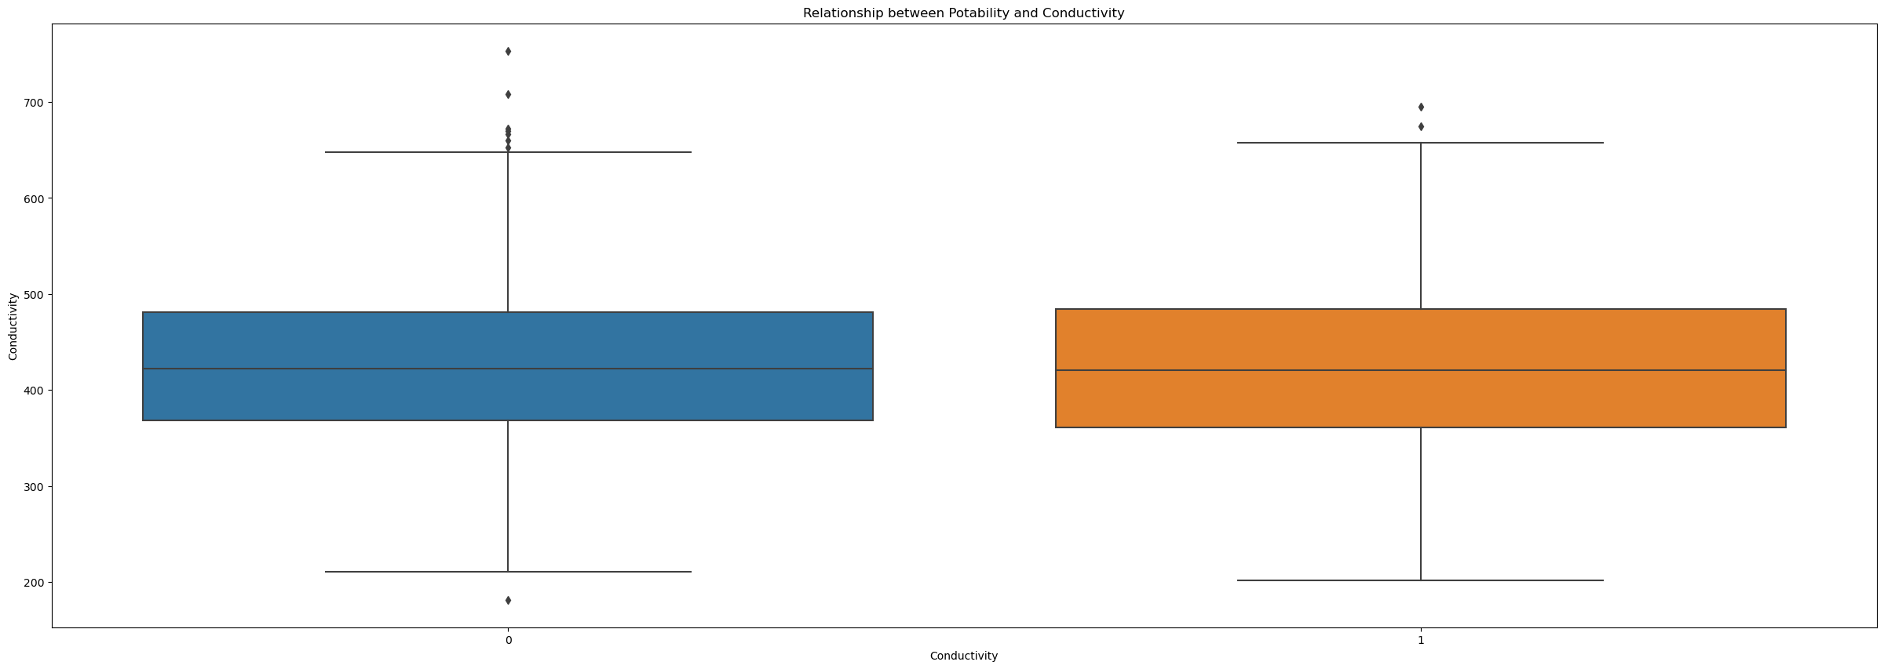
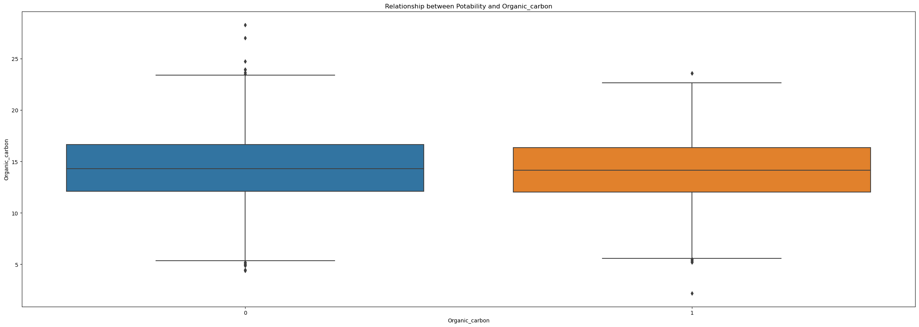

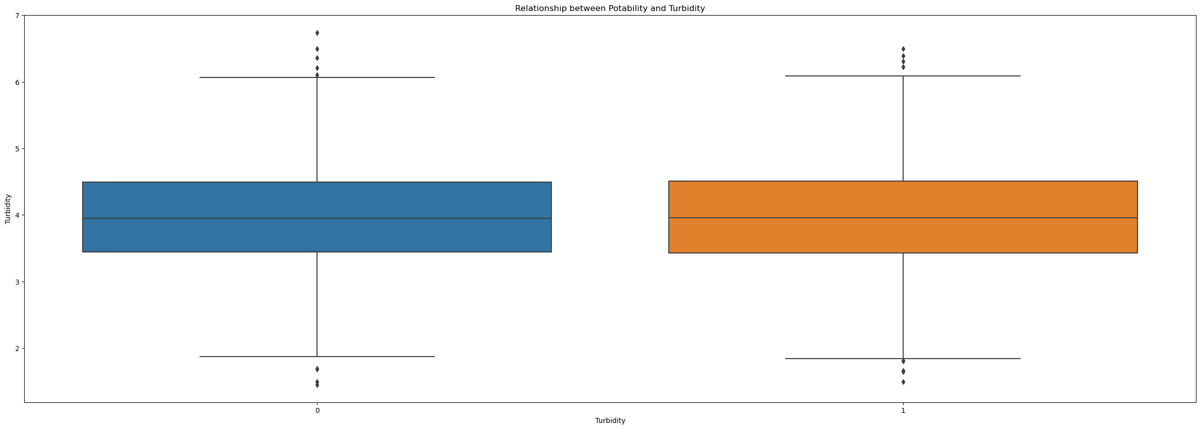
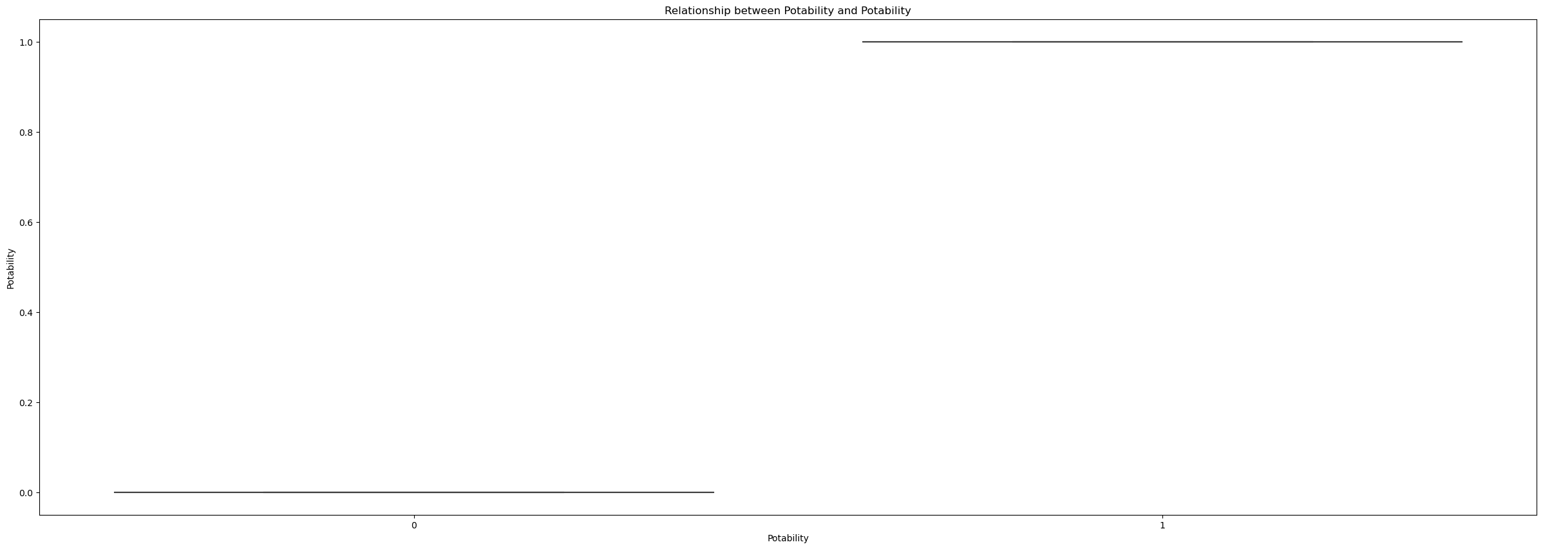

Slide 20
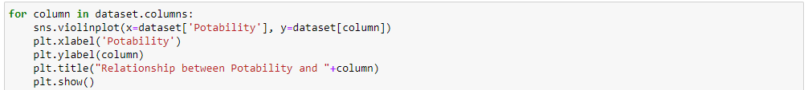
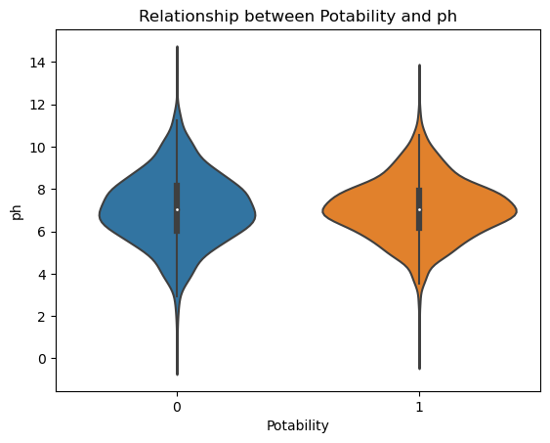
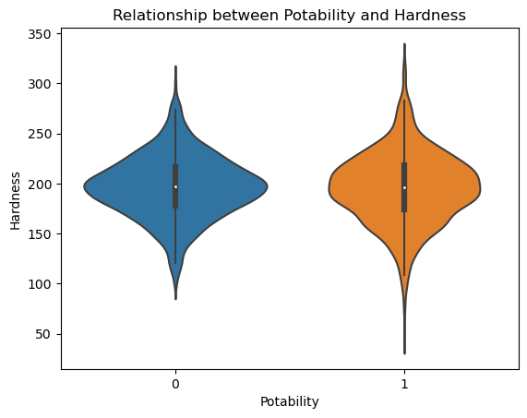
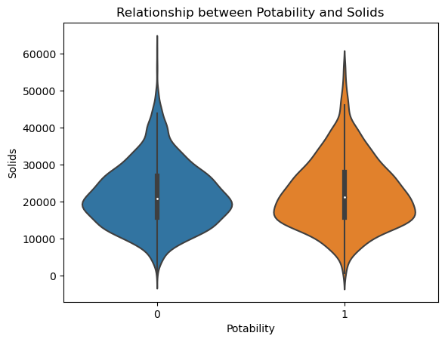

Slide 21
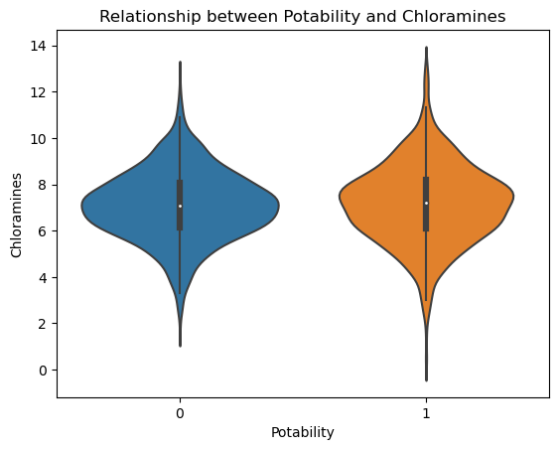
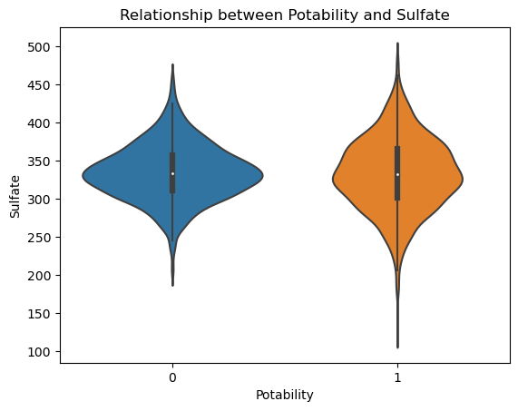
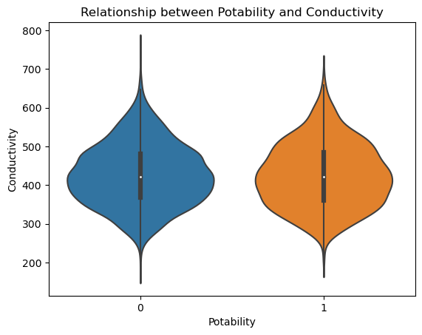
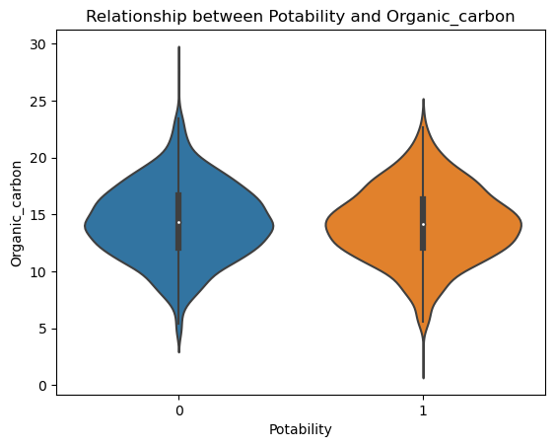
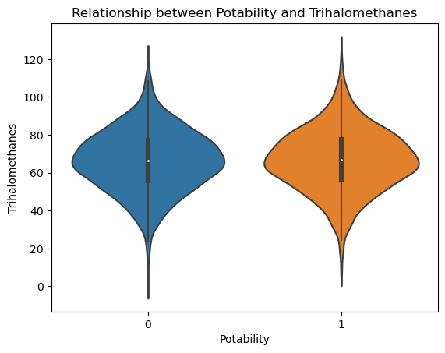
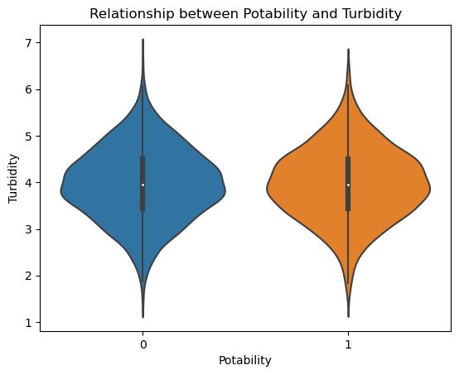

Slide 22
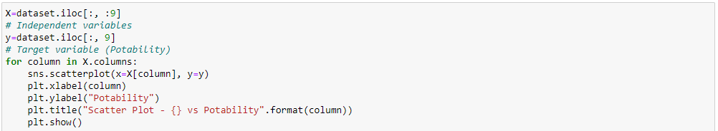
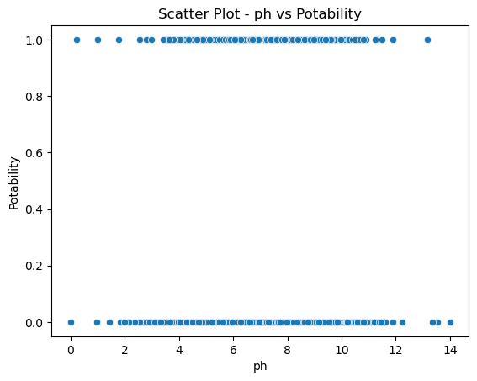
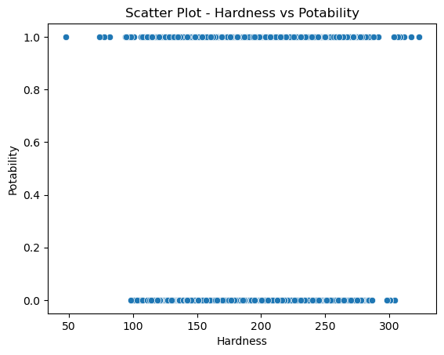
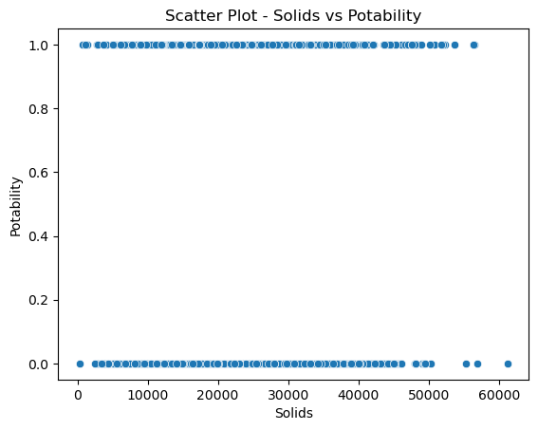

Slide 23
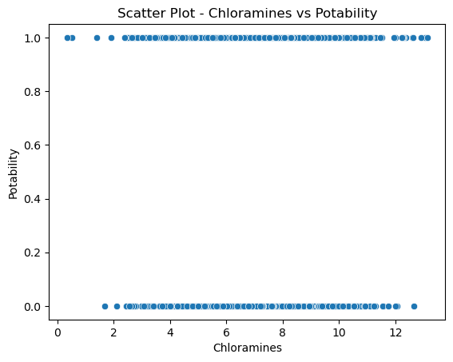
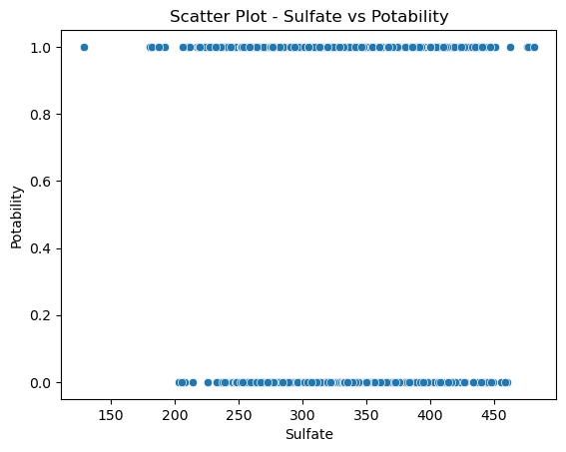
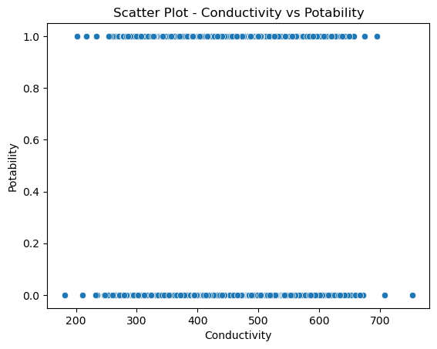
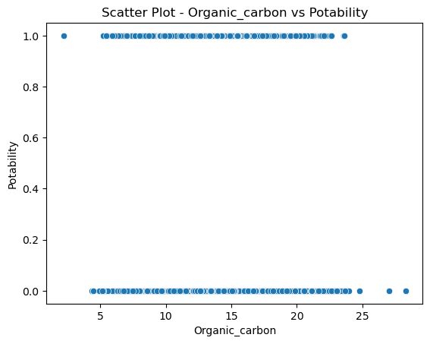



Slide 24


Slide 25





Slide 26







Slide 27





Slide 28







Slide 29





Slide 30







Slide 31





Slide 32







Slide 33





Slide 34







Slide 35



Slide 36





Slide 37







Slide 38


Slide 39


Slide 40



Pre-Processing
Term Project

Slide 41



Slide 42


Slide 43



Slide 44

Pre-Processing - Missing Value (pH)
Scientists measure the hardness of water using various methods, including the pH scale, which quantifies the concentration of hydrogen ions in the liquid. Water with a low pH is considered more acidic, while water with a higher pH is deemed harder or more alkaline due to its ability to neutralize acids.
The pH scale ranges from 1 to 14, with 7 representing neutrality. Substances below 7 are considered acidic, and those above 7 are alkaline. By measuring the pH level, scientists can assess the hardness or alkalinity of water.

Slide 45



Slide 46

Pre-Processing - Missing Value (Sulfate)
Sulfate is naturally occurring in various sources, including minerals, soil, rocks, and water. Seawater typically contains around 2,700 milligrams per liter (mg/L) of sulfate. In most freshwater supplies, sulfate concentrations range from 3 to 30 mg/L. However, it is important to note that the dataset provided only includes sulfate data ranging from 129 to 481 mg/L.
To address the missing values, we can calculate the mean sulfate concentration separately for the potable (safe for drinking) and non-potable (not safe for drinking) rows. The difference between these two categories is approximately 2 mg/L.

Slide 47


Slide 48

Pre-Processing - Missing Value (Trihalomethanes)
Trihalomethanes (THMs) are chemicals that can be present in water treated with chlorine. The concentration of THMs in drinking water can vary depending on several factors, including the level of organic material in the water, the amount of chlorine used for treatment, and the water temperature during treatment.
It is important to note that the dataset does not provide specific information regarding the THM concentrations. However, it is generally considered safe for drinking water to have THM levels up to 80 parts per million (ppm).

Slide 50


Slide 51


Slide 52



Slide 53

The duplicated() function in pandas is used to identify and mark duplicate values in a Dataset. It returns a boolean Series that indicates whether each row is a duplicate or not. The duplicated() function is useful for identifying and handling duplicate values in a dataset, such as removing duplicates or performing further analysis on the unique values.

Slide 54



Slide 55




Slide 56







Slide 57

Numerical Representations
In order to handle categorical variables in our dataset, we can apply encoding techniques to convert them into numerical representations. There are several methods available for encoding, such as one-hot encoding or label encoding.
One-hot encoding creates binary columns for each unique category, representing the presence or absence of that category in each observation. Label encoding, on the other hand, assigns a numeric label to each unique category.
However, in the current dataset, there is no need to perform any encoding because the variables are already in numeric format and do not contain categorical data. Therefore, there is no requirement for applying encoding techniques in this particular dataset.

Slide 58



Correlation
Term Project

Slide 59

Correlation
Heatmaps are a popular visualization method for displaying the correlation matrix, which depicts the relationships between variables using a color scale. Darker colors represent higher positive correlations, while lighter colors indicate higher negative correlations.

Slide 60



Slide 61



Slide 62


Slide 63



Machine Learning Algorithms
Term Project

Slide 64



Slide 65



Linear Regression
Term Project

Slide 66
Linear Regression
Linear regression is a statistical modeling technique that examines the linear relationship between a dependent variable and one or more independent variables. It is a machine learning algorithm commonly used for estimating the dependent variable based on a given set of independent variables. By fitting a linear equation to the observed data, linear regression enables the prediction or estimation of the dependent variable using the values of the independent variables. It is widely employed in various fields to analyze and understand the relationship between variables and make predictions based on that relationship.

Slide 67



Slide 68

The given code snippet performs the following steps:
Predictions are made on the training dataset (X_train) using the trained linear regression model (linearRegression). The predicted values are assigned to the variable y_train_pred.
Predictions are made on the test dataset (X_test) using the same linear regression model. The predicted values are assigned to the variable y_test_pred.
The training error is calculated by subtracting the predicted values (y_train_pred) from the actual values (y_train). The resulting error values are stored in the variable train_error.
Similarly, the test error is calculated by subtracting the predicted values (y_test_pred) from the actual values (y_test). The test error values are stored in the variable test_error. In summary, the code computes the predicted values for the dependent variable based on the independent variables for both the training and test datasets. It then calculates the error values by comparing the predicted values with the actual values for evaluation purposes.

Slide 69


In the given code, the training and test error values (train_error and test_error) are combined into a single DataFrame called all_errors using the pd.concat() function. This allows for a comprehensive analysis of the error distribution across both datasets. Next, the error distribution is visualized using a histogram. The plt.hist() function is used to create the histogram, with all_errors as the input data and bins=20 specifying the number of bins or intervals to divide the data. Additional plotting functions (plt.xlabel(), plt.ylabel(), plt.title()) are used to set the labels and title for the plot, providing clarity and context to the visualization. Finally, plt.show() is called to display the histogram plot. The histogram allows for a visual assessment of the frequency or count of error values within each bin, enabling an understanding of the error distribution and potential patterns or outliers. This can provide insights into the performance and accuracy of the predictive model.

Slide 70


In the given code, the actual values of the dependent variable from both the training and test datasets (y_train and y_test) are combined into a single array called y_combined using the np.concatenate() function. Similarly, the predicted values of the dependent variable from both datasets (y_train_pred and y_test_pred) are combined into y_pred_combined. A scatter plot is then created using plt.scatter() to visualize the relationship between the actual values and the estimated values. The y_combined array represents the actual values, while the y_pred_combined array represents the estimated values. The plt.xlabel(), plt.ylabel(), and plt.title() functions are used to set the labels for the x-axis, y-axis, and the title of the plot, respectively. This provides clear and informative labeling for the scatter plot. Finally, plt.show() is called to display the scatter plot, allowing for a visual comparison between the actual values and the estimated values. This plot can help assess the accuracy and performance of the linear regression model by examining how closely the estimated values align with the actual values.

Slide 71

In the provided code, the following metrics are calculated to evaluate the performance of the linear regression model:
mean_absolute_error(y_test, y_test_pred): This function computes the mean absolute error (MAE) by taking the absolute difference between the actual values (y_test) and the predicted values (y_test_pred) for the test dataset.
mean_squared_error(y_test, y_test_pred): This function calculates the mean squared error (MSE) by computing the squared difference between the actual values (y_test) and the predicted values (y_test_pred) for the test dataset, and then taking the average.
r2_score(y_test, y_test_pred): This function calculates the R-squared score, also known as the coefficient of determination, which measures the proportion of the variance in the dependent variable (y_test) that can be explained by the independent variables (y_test_pred). It provides an indication of how well the linear regression model fits the data. The computed metrics are then printed using print() statements, displaying the MAE, MSE, and R-squared score for the model's predictions on the test dataset.
Now let's try to fix our scores.

Slide 72


Linear Regression with Standard Deviations
Linear Regression with Polinomiyal Regression

Slide 73



Cross Validate
Term Project

Slide 74

Cross Validate
Cross-validation is a technique employed to assess and evaluate the performance of a model.

Slide 75


Slide 76


Slide 77



KNN
Term Project

Slide 78

KNN
K-Nearest Neighbors (KNN) is a machine learning algorithm that can be used for both classification and regression tasks. It operates based on the concept of proximity or closeness between data points. In classification, KNN determines the class of a new data point by considering the classes of its K nearest neighbors. The class that appears most frequently among the K nearest neighbors is assigned to the new data point. In regression, KNN estimates the value of a target variable for a new data point by averaging or taking the weighted average of the target variable values of its K nearest neighbors. KNN relies on the assumption that similar instances or data points tend to have similar outputs or labels. It is a non-parametric algorithm, meaning it does not make explicit assumptions about the underlying data distribution. KNN is simple and intuitive, making it widely used in various domains for pattern recognition, recommendation systems, and data analysis tasks.

Slide 79

To ensure the proper application of the KNN algorithm, it is common practice to scale the features so that they have the same scale. This process, known as feature scaling or normalization, aims to bring each feature in the dataset to a consistent scale. Feature scaling is important because the KNN algorithm calculates distances between data points to determine their proximity. If the features have different scales, those with larger magnitudes can dominate the distance calculation and overshadow the contribution of features with smaller scales. By normalizing the features, each feature is transformed to a comparable range, preventing any feature from dominating the distance calculation solely due to its scale. Common methods for feature scaling include standardization and normalization. Standardization rescales the features to have a mean of zero and a standard deviation of one, while normalization scales the features to a specific range, such as between 0 and 1. By scaling the features to the same scale, the KNN algorithm can more effectively measure the similarity or closeness between data points based on all the features collectively, leading to more accurate and reliable results.

Slide 80



Slide 81

Initial Results:
Accuracy Score: 0.6173780487804879
Precision Score: 0.6173780487804879
Recall Score: 0.6173780487804879
F1 Score: 0.6173780487804879
The initial results show that the KNN model achieved an accuracy of approximately 0.62. Precision, recall, and F1 score are also around 0.62. These scores indicate that the model's performance is moderate.
Now let's try to fix our scores.

Slide 82

We use the scaling feature before applying KNN to our dataset

Slide 83
To ensure the proper functioning of the KNN algorithm, it is commonly recommended to scale the features so that they have the same magnitude. This scaling process, known as feature normalization, helps standardize the features and bring them to a comparable scale. By normalizing the features, we can effectively represent each feature on an equal footing, preventing any feature from dominating the distance calculations in the KNN algorithm.
Improved Results with Feature Scaling:
Accuracy Score: 0.6722560975609756
Precision Score: 0.6722560975609756
Recall Score: 0.6722560975609756
F1 Score: 0.6722560975609756
After applying feature scaling to the dataset, the model's performance improved. The accuracy, precision, recall, and F1 score increased to approximately 0.67. This indicates that scaling the features helped the model to make more accurate predictions.

Slide 84




We will reduce our test size to (0.1)

Slide 85
Reduced Test Size:
Accuracy Score: 0.6829268292682927
Precision Score: 0.6829268292682927
Recall Score: 0.6829268292682927
F1 Score: 0.6829268292682927
By reducing the test size, the model's performance improved further. The accuracy, precision, recall, and F1 score increased to approximately 0.68. This suggests that reducing the test size allowed the model to generalize better and make more accurate predictions on unseen data.
Overall, the results show that applying feature scaling and reducing the test size had a positive impact on the model's performance. However, it's important to note that these results are specific to the given dataset and the chosen parameters for the KNN algorithm.

Slide 86



Decision Tree
Term Project

Slide 87
Decision Tree
The Decision Tree algorithm is a versatile machine learning algorithm that can be applied to both classification and regression problems. It constructs a hierarchical structure of decision rules based on the features present in the dataset. These decision rules are utilized to classify or predict the values of new, unseen data points.
In classification tasks, the Decision Tree algorithm partitions the feature space into regions by recursively splitting the data based on the values of different features. Each internal node of the tree represents a decision based on a specific feature, while the leaf nodes correspond to the class labels or categories.
In regression tasks, the Decision Tree algorithm performs a similar process by recursively splitting the data based on feature values. However, instead of class labels, the leaf nodes contain the predicted numeric values.
By employing a set of decision rules inferred from the training data, Decision Trees offer interpretable models that can handle both categorical and numerical features. They can capture complex relationships between variables and are known for their ability to handle both linear and non-linear data patterns.
Overall, the Decision Tree algorithm is a powerful tool for solving classification and regression problems by constructing a set of decision rules that guide the prediction or classification of new data points.

Slide 88


The results with a test size of 0.1 show that the Decision Tree model achieved an accuracy of approximately 0.55. The precision, recall, and F1 score are also around 0.55. These scores indicate that the model's performance is moderate, but there is room for improvement.
Now let's try to fix our scores.

Slide 89


We will reduce our test size to (0.2)
After reducing the test size to 0.2, the model's performance improved. The accuracy, precision, recall, and F1 score increased to approximately 0.59. This indicates that having a larger test set helped the model to generalize better and make more accurate predictions.
Overall, the results suggest that increasing the test size from 0.1 to 0.2 improved the performance of the Decision Tree classifier. However, it's important to note that these results are specific to the given dataset and the chosen parameters for the Decision Tree algorithm.

Slide 90



PCA
Term Project

Slide 91
PCA
Principal Component Analysis (PCA) is a statistical technique employed to explore and analyze the relationships among variables in a dataset, as well as to perform dimensionality reduction.
PCA aims to transform a high-dimensional dataset into a lower-dimensional representation while retaining as much information as possible. It achieves this by identifying the principal components, which are linear combinations of the original variables that capture the most significant variation in the data.
By reducing the dimensionality of the dataset, PCA helps simplify complex data structures and facilitates data visualization. It allows for a better understanding of the underlying patterns, correlations, and dependencies among variables. Additionally, PCA can be used as a preprocessing step to remove redundant or irrelevant features, leading to improved computational efficiency and mitigating the effects of the curse of dimensionality.
Overall, PCA is a valuable tool in exploratory data analysis, feature engineering, and data compression, providing insights into the structure of the data and enabling more efficient and effective data analysis and modeling.

Slide 92


The results without using PCA show that the KNN model achieved an accuracy of approximately 0.62. The precision, recall, and F1 score are also around 0.62. These scores indicate that the model's performance is moderate, but there is room for improvement.

Slide 93


When PCA (Principal Component Analysis) is applied with 3 components, the model's performance decreases. The accuracy, precision, recall, and F1 score are all around 0.53. This suggests that the reduced dimensionality through PCA may have caused information loss, resulting in a less accurate model.

Slide 94
Overall, the results indicate that using PCA with the given number of components did not improve the performance of the KNN classifier. In fact, it led to a decrease in accuracy and other performance metrics. It's important to note that the effectiveness of PCA depends on the dataset and the underlying structure of the data. In this case, it seems that the original feature space without PCA provided better results.
There could be several reasons why PCA resulted in a lower performance:
Information loss: PCA focuses on the variability in the dataset and may result in the loss of some information. When selecting the components of PCA, we try to choose the components that best explain the variability in the dataset, but it can sometimes lead to ignoring some important features. In this case, using PCA can cause the loss of certain features of the dataset, leading to lower performance.
Effect of dimensionality reduction: PCA is one of the dimensionality reduction methods. Dimensionality reduction aims to reduce the complexity of the dataset by reducing the number of features. However, sometimes, as a result of dimensionality reduction, we may lose some information in the dataset. This can also result in lower performance.
Selection of PCA components: The performance of PCA depends on the number of components selected and how well these components explain the variability in the dataset. If you don't select enough components or choose the most suitable components, you may achieve lower performance.
Due to these reasons, using PCA for dimensionality reduction or transforming the dataset may not always yield better results. By evaluating the reasons for the low performance, you can try different dimensionality reduction methods or adjust different parameters. Additionally, it is important to understand the characteristics of your dataset and make decisions considering the advantages and limitations of PCA.

Slide 95





Slide 96



Random Forest
Term Project

Slide 97

Random Forest
Random Forest is an ensemble algorithm composed of multiple decision trees. Each decision tree in the Random Forest is trained independently using random sampling and random feature selection. During the training process, random subsets of the original dataset are sampled with replacement, and these subsets are used to grow individual decision trees. Additionally, at each split in the tree, a random subset of features is considered for determining the best split. The predictions of the individual decision trees are then combined to make a final prediction. In classification tasks, the most common predicted class among the trees is selected, while in regression tasks, the average or weighted average of the predicted values from the trees is calculated. Random Forests are known for their ability to reduce overfitting and improve generalization by combining the predictions of multiple trees. They are robust against noise and outliers and are widely used for various machine learning tasks, including classification, regression, and feature importance estimation.

Slide 98


In this case, the Random Forest model achieved relatively high performance on the test data without applying PCA. The scores for accuracy, precision, recall, and F1 indicate that the model performed well in predicting the target variable.
Now let's try to fix our scores.

Slide 99


Random Forest with PCA
When PCA was applied with 3 principal components, the performance of the RF model decreased compared to the previous case without PCA. The scores for accuracy, precision, recall, and F1 are lower, indicating that the model's predictive power diminished after reducing the dimensionality of the data using PCA.
In summary, the RF model performed better on the dataset without PCA, achieving higher accuracy, precision, recall, and F1 scores. This suggests that the original features had important information for the classification task, and reducing the dimensionality with PCA did not improve the model's performance in this case.

Slide 100



Support Vector Machines
Term Project

Slide 101

Support Vector Machines
Support Vector Machines (SVM) is a versatile machine learning algorithm that can be applied to both classification and regression problems. It aims to find an optimal hyperplane that effectively separates the data points. In classification tasks, SVM seeks to find a hyperplane that maximizes the margin between different classes. The hyperplane acts as a decision boundary, allowing SVM to classify new data points into one of the predefined classes based on which side of the hyperplane they fall on. In regression tasks, SVM aims to find a hyperplane that best fits the data points, minimizing the error between the predicted values and the actual target values. It uses a subset of data points, called support vectors, to construct the hyperplane. The primary objective of SVM is to achieve the best possible separation or fitting of the data points while maximizing the margin or minimizing the error. It is capable of handling both linearly separable and non-linearly separable data by using different kernel functions that transform the data into higher-dimensional feature spaces. SVM is widely used in various domains such as image classification, text classification, and bioinformatics, where it has demonstrated strong performance and generalization capabilities.

Slide 102


In this case, SVM achieved moderate performance on the test data without applying PCA or standardizing the features. The scores for accuracy, precision, recall, and F1 indicate that the model's predictions were moderately accurate.
Now let's try to fix our scores.

Slide 103


Support Vector Machines (SVM) with Standard deviations
When the features were standardized before training the SVM model, the performance improved. The scores for accuracy, precision, recall, and F1 are higher, indicating that standardization helped the SVM model in making better predictions.

Slide 104


Support Vector Machines (SVM) with PCA
After applying PCA with 3 principal components, the performance of the SVM model remained the same as the case without PCA. The scores for accuracy, precision, recall, and F1 are consistent, suggesting that reducing the dimensionality with PCA did not significantly affect the model's performance.

Slide 105



Clustering
Term Project

Slide 106

Clustering
Clustering is a machine learning technique utilized to group data based on shared characteristics or similarities. Clustering algorithms aim to identify clusters or subgroups within a dataset by measuring the similarity or distance between data points.
The goal of clustering is to create clusters where the data points within each cluster are more similar to each other compared to data points in different clusters. The similarity measure can be based on various factors such as distance, density, or connectivity among data points.
Clustering is an unsupervised learning method, meaning it does not rely on predefined labels or target variables. Instead, it explores the inherent structure or patterns in the data to form meaningful clusters. Clustering is employed in diverse domains, including customer segmentation, image recognition, anomaly detection, and social network analysis, to gain insights and extract valuable information from complex datasets.

Slide 107
Clustering
The Elbow method is a technique used in clustering analysis to determine the optimal number of clusters in a dataset. It operates by evaluating the total inertia or within-cluster sum of squares as the number of clusters increases. In this method, the total inertia value tends to decrease as the number of clusters increases because each data point is assigned to a cluster. However, the rate of decline of the inertia value typically slows down at a certain point. The Elbow method aims to identify this "elbow" point, which signifies a diminishing return in the reduction of inertia with the addition of more clusters. To determine the optimal number of clusters, the Elbow method involves calculating the inertia values for different cluster numbers and plotting them on a graph. The inertia values are typically plotted on the y-axis, while the number of clusters is plotted on the x-axis. By examining the resulting graph, one looks for the point where the rate of decline in the inertia value significantly slows down, forming an elbow-like shape. This point suggests the appropriate number of clusters for the given dataset. By using the Elbow method, one can make an informed decision on the optimal number of clusters to use in subsequent clustering analyses, helping to achieve a balance between capturing the inherent structure in the data and avoiding excessive complexity.

Slide 108





Slide 109



Logistic Regression
Term Project

Slide 110

Logistic Regression
Logistic Regression is a statistical learning algorithm used for binary classification tasks. It is a supervised learning method that predicts the probability of an instance belonging to a particular class. Unlike linear regression, which predicts continuous numeric values, logistic regression models the relationship between the independent variables and the probability of an event occurring. It is particularly suitable for problems where the dependent variable or the target variable is binary (e.g., yes/no, true/false, 0/1). Logistic Regression employs the logistic function (also known as the sigmoid function) to transform the linear regression output into a probability value between 0 and 1. This probability is then used to classify instances into the respective classes based on a predefined threshold. The model is trained using a maximum likelihood estimation approach to find the optimal coefficients that maximize the likelihood of the observed data. Regularization techniques such as L1 or L2 regularization can be applied to prevent overfitting. Logistic Regression is widely used in various fields, including healthcare, finance, marketing, and social sciences, for tasks such as spam detection, fraud detection, customer churn prediction, and medical diagnosis.

Slide 111


In this case, Logistic Regression achieved moderate performance on the test data without applying PCA or standardizing the features. The scores for accuracy, precision, recall, and F1 indicate that the model's predictions were moderately accurate.
Now let's try to fix our scores.

Slide 112


Logistic Regression with Standard Deviations
When the features were standardized before training the Logistic Regression model, the performance remained the same as the case without standardization. The scores for accuracy, precision, recall, and F1 are consistent, indicating that standardization did not significantly affect the model's performance in this case.

Slide 113


Logistic Regression with PCA
After applying PCA with 3 principal components, the performance of the LR model remained the same as the case without PCA. The scores for accuracy, precision, recall, and F1 are consistent, suggesting that reducing the dimensionality with PCA did not have a significant impact on the model's performance.
In summary, both standardization and PCA did not result in noticeable improvements in the performance of the LR model for this dataset. The model's performance remained moderate across all three scenarios.

Slide 114


Gaussian Naive Bayes
Term Project

Slide 115


The model achieved moderate performance on the test data with all metrics (accuracy, precision, recall, and F1 score) around 0.63. These scores indicate that the model is making predictions correctly for approximately 63% of the instances.
Now let's try to fix our scores.

Slide 116


Gaussian Naive Bayes with Standard Deviations
When the data is standardized using standard deviations, the performance of the model slightly improves. The accuracy, precision, recall, and F1 score are all around 0.63, indicating a similar level of performance as the previous model.
Overall, both models achieve similar results with decent but not exceptional performance.

Slide 117




6 Classification Algorithms Example

Slide 118
K-Nearest Neighbors (KNN):
Accuracy: 0.6326219512195121
Precision: 0.6326219512195121
Recall: 0.6326219512195121
F1-score: 0.6326219512195121
The KNN algorithm achieved moderate performance on the test data, with accuracy, precision, recall, and F1-score around 0.63. This means that the model correctly predicted the class for approximately 63% of the instances.
Decision Tree (DT):
Accuracy: 0.6798780487804879
Precision: 0.6798780487804879
Recall: 0.6798780487804879
F1-score: 0.6798780487804879
The decision tree algorithm performed better than KNN, with all metrics around 0.68. It shows a higher accuracy in predicting the class labels.
Random Forest (RF):
Accuracy: 0.7621951219512195
Precision: 0.7621951219512195
Recall: 0.7621951219512195
F1-score: 0.7621951219512195
The random forest algorithm achieved the highest performance among the tested algorithms. It shows an accuracy, precision, recall, and F1-score around 0.76, indicating a good ability to classify instances.

Slide 119

Support Vector Machines (SVM):
Accuracy: 0.698170731707317
Precision: 0.698170731707317
Recall: 0.698170731707317
F1-score: 0.698170731707317
The SVM algorithm performed decently, with all metrics around 0.70. It shows a moderate level of accuracy in predicting the class labels.
Logistic Regression (LR):
Accuracy: 0.6280487804878049
Precision: 0.6280487804878049
Recall: 0.6280487804878049
F1-score: 0.6280487804878049
The logistic regression algorithm achieved performance like KNN, with all metrics around 0.63. It shows a moderate level of accuracy in classification.
Gaussian Naive Bayes (NB):
Accuracy: 0.6310975609756098
Precision: 0.6310975609756098
Recall: 0.6310975609756098
F1-score: 0.6310975609756098
The Gaussian Naive Bayes algorithm performed similarly to KNN and LR, with all metrics around 0.63. It shows a moderate level of accuracy in classification.

Slide 120


References
https://www.kaggle.com/datasets/adityakadiwal/water-potability
https://www.coursera.org/articles/machine-learning-algorithms
https://en.wikipedia.org/wiki/Machine_learning
https://towardsdatascience.com/top-machine-learning-algorithms-for-classification-2197870ff501
Thank You
Akın Kemal DOĞANGÜN
https://www.doftdare.com/

